Slide 1
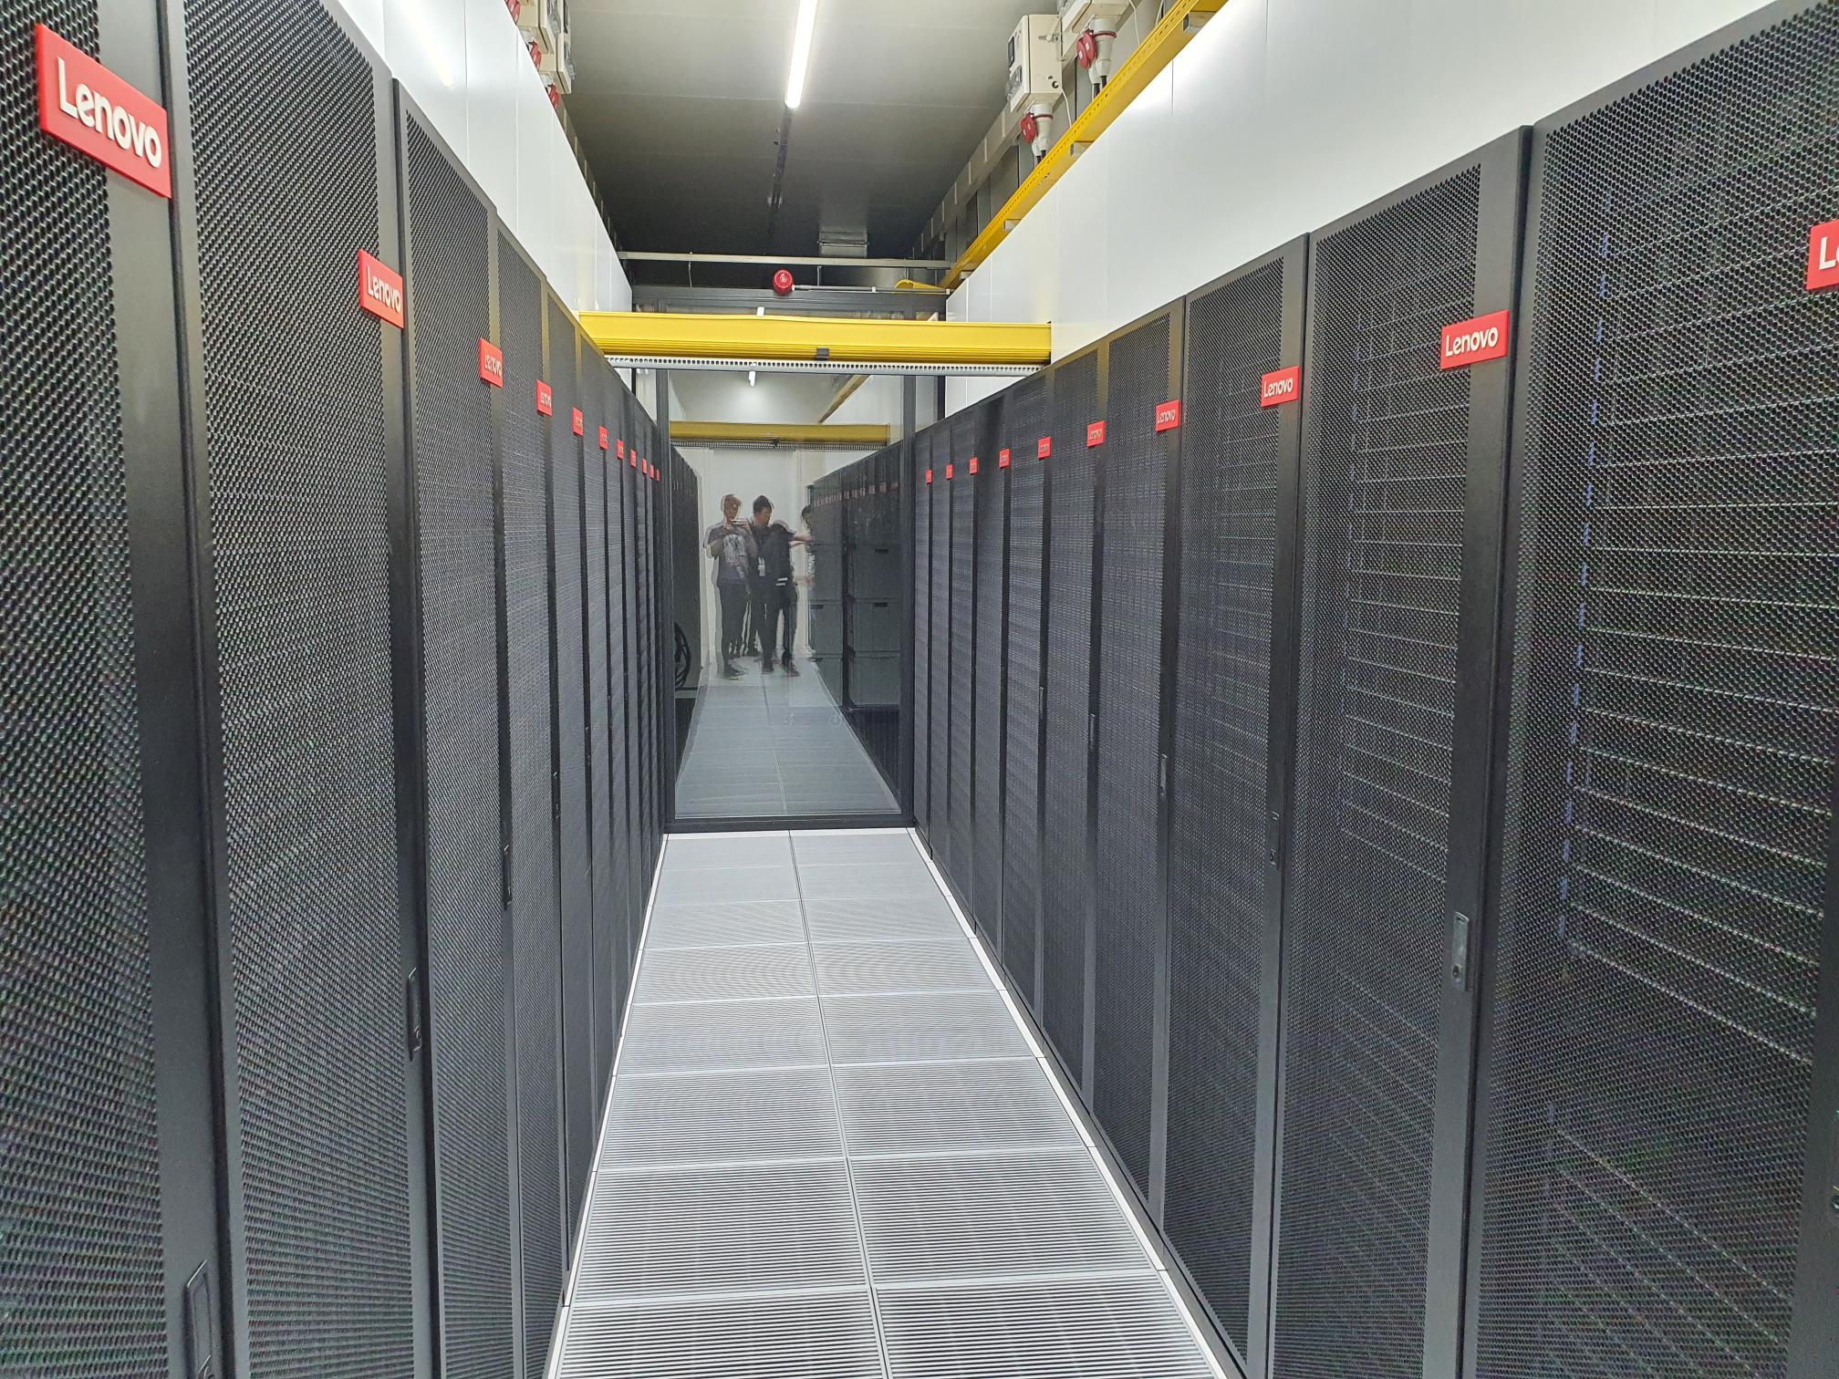

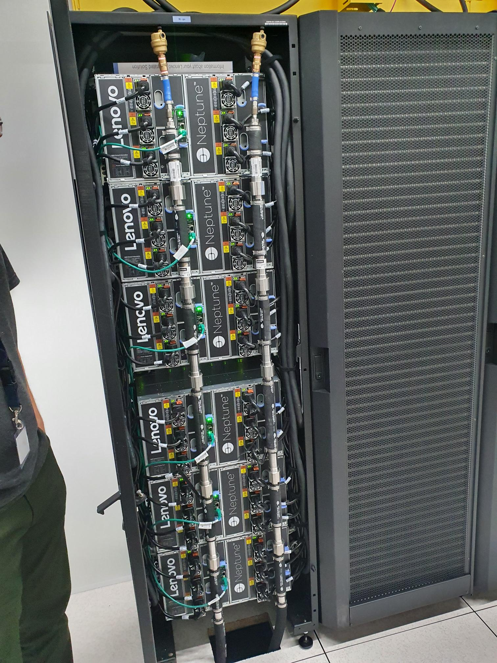
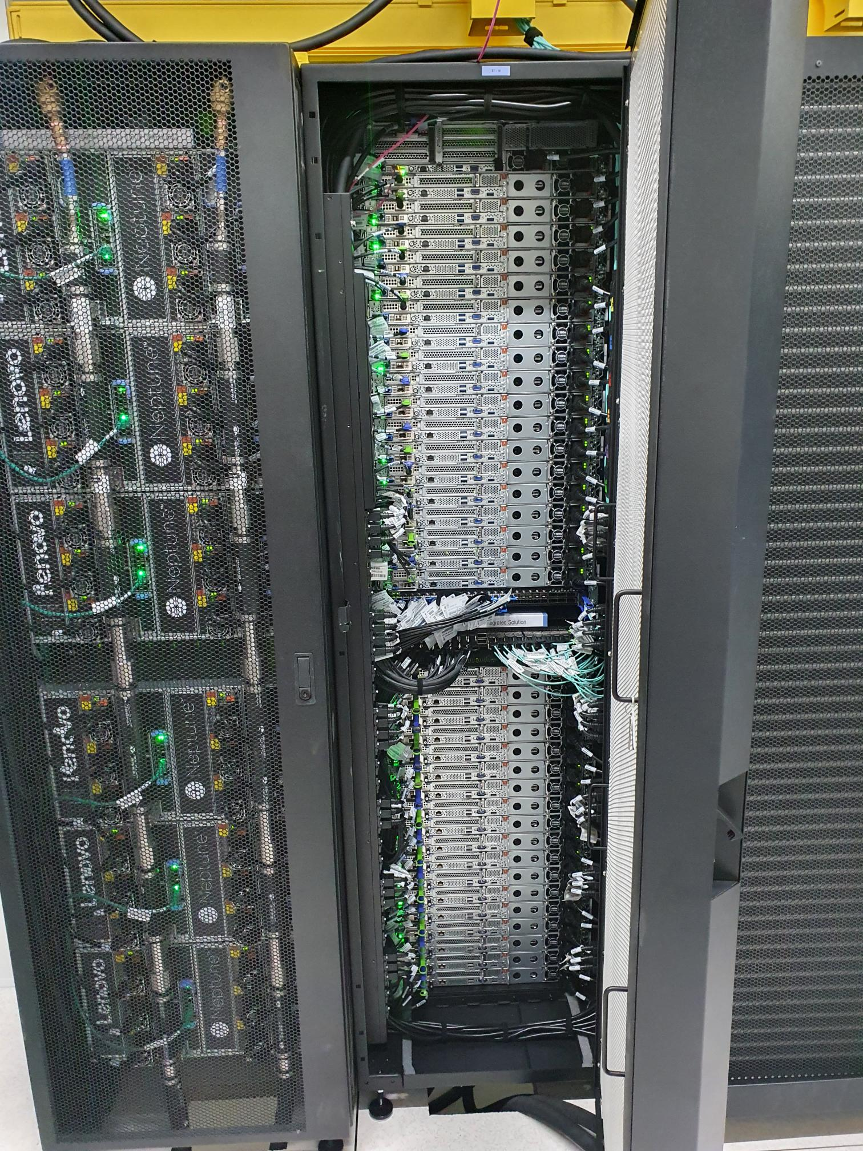

Make Snellius go fast(er)
Robert Jan Schlimbach & Lars Veefkind
Team High-Performance Machine-Learning

Slide 2

Who am I & What does SURF do
Me:
UvA AI grad
HPC ML advisor at SURF
Love making code go fast
Love running, climbing, and mountains
SURF
Help academia in a very broad sense
Eduroam, SurfConext, SurfMarket, National Supercomputer, etc...

Slide 3
The program
Quick intro to Snellius and the three S' (20 minutes)
The big fat list of ML optimization on Snellius (10 minutes)
Profiling PyTorch (60 minutes)

Slide 4
What is a supercomputer/clustercomputer
Practically: a bunch of (very big) computers tied together
Uses hardware/software which is not available for regular consumers
Very fast Interconnect
Ethernet/IB/GPU-direct
Very fast Storage
Tiered: NVME/Hard-disk/Tape
Very fast Compute
Accelerators
Huge CPUs
Massive amounts of RAM

Slide 5
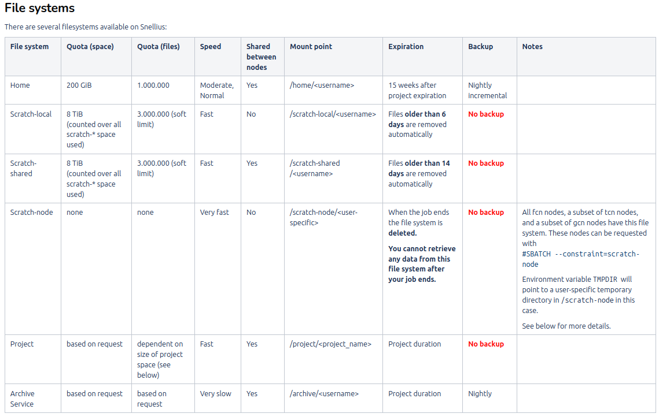
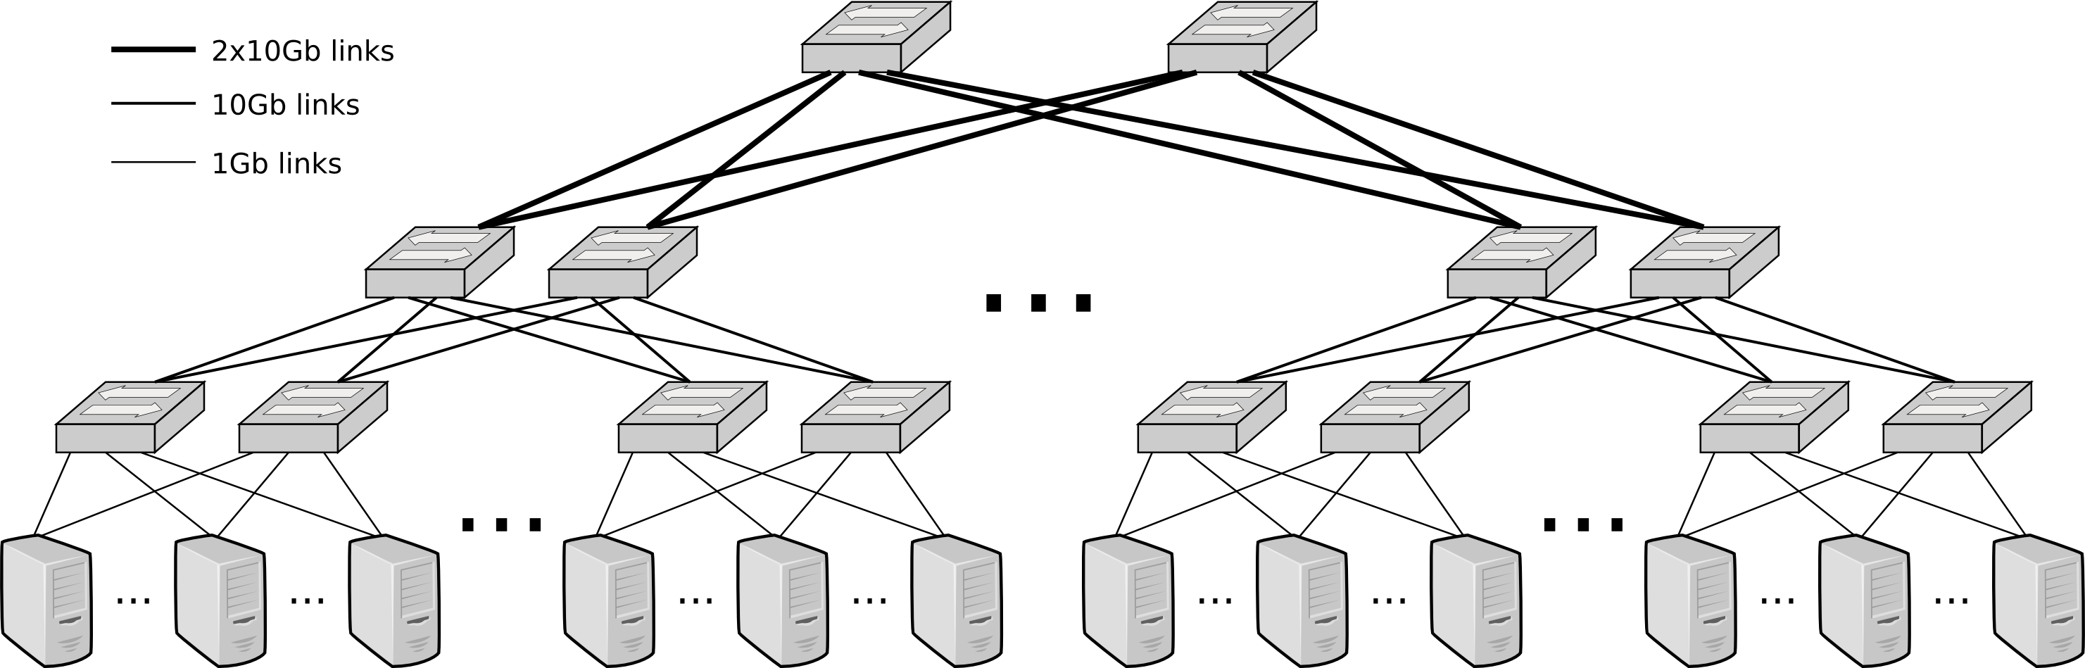
Snellius
~1300 CPU-based nodes
128-192 cores
256-378 GB RAM
~100 high-memory nodes
1TB-8TB RAM
160 GPU nodes
x4 nvidia A100s / H100s
512GB RAM
40GB /94 GB VRAM
Storage:
~13PB of medium-speed storage project space
720TB of home-dir
210TB of NVME
Interconnect: 100GBps Infiniband fat-tree

Slide 6
The three S'
Know your System
What kind of hardware do I have?
What features does my hardware support?
Know your Software
Does my software do what I want to do efficiently?
Does my software support my hardware features?
Know your Stack
What version of software am I running?
Is my stack compiled for my hardware?

Slide 7
System
Which CPUs?
Architectures: X86_64, ARM64
What kind of storage?
SSD, HDD, Tape?
SATA, NVMe or full PCI-E?
What kind of Networking?
Ethernet? InfiniBand (IB)?
IOPs vs Throughput
What kind of RAM?
High Bandwidth Memory (HBM) or Data Double Rate (DDR)?
How much? Enough for a RAMdisk?
You (AI person) are always memory limited
Which GPUs?
AMD? Good raw performance, poor PyTorch support (for now)
NVIDIA? Optimized for AI with good PyTorch support.
https://servicedesk.surf.nl/wiki/display/WIKI/Snellius+hardware+and+file+systems

Slide 8
System
Goals:
Understand what hardware bottlenecks could be limitting
Understand pro’s and con’s of various hardware
Know how to choose appropriate hardware for you DL task
Know what to do to mitigate bottlenecks

Slide 9

System
Compute (floating point operations per second, FLOPS)
Memory bandwidth
Memory size
I/O
Communication

Slide 10
System
E.g. training a compute intensive network on a single node
Compute (floating point operations per second, FLOPS)
Memory bandwidth
Memory size
I/O
Communication

Slide 11
System
Compute (floating point operations per second, FLOPS)
Memory bandwidth
Memory size
I/O
Communication
Data needs to get to the processor in time in order to do compute!
Many codes are limited by memory bandwidth

Slide 12
System
Compute (floating point operations per second, FLOPS)
Memory bandwidth
Memory size
I/O
Communication
Very deep or wide networks, or networks with very large input/output layers (e.g. high resolution images) may be limited by memory size.
Not a performance bottleneck, but a no-go!

Slide 13
System
Compute (floating point operations per second, FLOPS)
Memory bandwidth
Memory size
I/O
Communication
HPC systems typically have shared file systems, usually with good bandwidth, but (relatively) low I/O operations per second (IOPS)
Common bottleneck in distributed learning! Many nodes reading from the same filesystem.
Other users (& sysadmins) will dislike you if you do I/O in a naive way!

Slide 14
System
Compute (floating point operations per second, FLOPS)
Memory bandwidth
Memory size
I/O
Communication
Communication can be limiting in several ways:
Latency (many, small message send between nodes)
Bandwidth (few, large messages send between nodes)
Load imbalance (some workers in distributed job are slower / have more work; others have to wait when synchronization is needed)
CPU <-> GPU

Slide 15
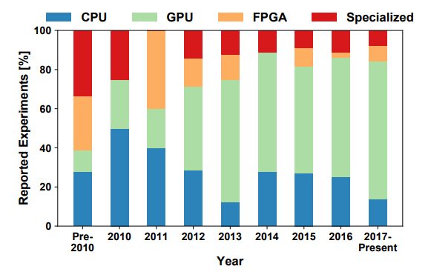
System
A look at the hardware, from a DL perspective:
Nvidia is dominant, Volta was a game changer
AMD is finally catching up
Specialized hardware losing favour
Same for CPUs
Source: Demystifying Parallel and Distributed Deep Learning: An In-Depth Concurrency Analysis, Ben-Nun & Hoefler 2018

Slide 16
Hardware overview
 | FP8 [TFLOPS] | INT8 [TOPS] | FP16 [TFLOPS] | Bloat16 [TFLOPS] | FP32 [TFLOPS] | FP64 [TFLOPS] | Memory [GB] | Memory Bandwidth [GB/s] | PCIe [GB/s] | Power draw [W] | FP16 TFLOP per Watt
AMD MI250 |  | 362.1 | 362.1 | 362.1 | 90.5 | 90.5 | 128 | 3276.8 | 31.51 | 560 | 0.64
AMD MI300x |  | 2615 | 1307 | 1307 | 654 | 163 | 192 | 5300 | 128 | 750 | 1.74
NVIDIA A100 |  | 624 | 312 | 312 | 156 | 19.5 | 40/80 | 1555-2039 | 64 | 400 | 0.78
NVIDIA H100 | 1979 | 1979 | 990 | 990 | 989 | 67 | 80/96 | 2000-3900 | 128 | 700 | 1.32
NVIDIA L40S (inference only) | 733 | 733 | 362 | 362 | 183 | 1.4 | 48 | 864 | 64 | 350 | 1.03
NVIDIA RTX 4090 (consumer) | 330 | 660 | 165 | 165 | 83 | 1.2 | 24 | 1000 | 64 | 400 | 0.41
Intel Xeon Scalable 8180 (per socket) |  | - | - |  | 4.2 | 2.1 | 768 (max) | 119 (max) | 15.75 | 205 | 0.02
AMD EPYC 7601 (per socket) |  | - | - |  | 1.4 | 0.69 | 2000 (max) | 159 (max) | 15.75 | 180 | 0.008
Prace best practice guide – deep learning
https://en.wikipedia.org/wiki/Ampere_(microarchitecture)
Notes:
Add H100, add watt en perf per watt, add a10 inference

Slide 17
Hardware overview
GPUs support reduced precision, has higher performance
 | FP8 [TFLOPS] | INT8 [TOPS] | FP16 [TFLOPS] | Bloat16 [TFLOPS] | FP32 [TFLOPS] | FP64 [TFLOPS] | Memory [GB] | Memory Bandwidth [GB/s] | PCIe [GB/s] | Power draw [W] | FP16 TFLOP per Watt
AMD MI250 |  | 362.1 | 362.1 | 362.1 | 90.5 | 90.5 | 128 | 3276.8 | 31.51 | 560 | 0.64
AMD MI300x |  | 2615 | 1307 | 1307 | 654 | 163 | 192 | 5300 | 128 | 750 | 1.74
NVIDIA A100 |  | 624 | 312 | 312 | 156 | 19.5 | 40/80 | 1555-2039 | 64 | 400 | 0.78
NVIDIA H100 | 1979 | 1979 | 990 | 990 | 989 | 67 | 80/96 | 2000-3900 | 128 | 700 | 1.32
NVIDIA L40S (inference only) | 733 | 733 | 362 | 362 | 183 | 1.4 | 48 | 864 | 64 | 350 | 1.03
NVIDIA RTX 4090 (consumer) | 330 | 660 | 165 | 165 | 83 | 1.2 | 24 | 1000 | 64 | 400 | 0.41
Intel Xeon Scalable 8180 (per socket) |  | - | - |  | 4.2 | 2.1 | 768 (max) | 119 (max) | 15.75 | 205 | 0.02
AMD EPYC 7601 (per socket) |  | - | - |  | 1.4 | 0.69 | 2000 (max) | 159 (max) | 15.75 | 180 | 0.008
Prace best practice guide – deep learning
https://en.wikipedia.org/wiki/Ampere_(microarchitecture)
Notes:
Add H100, add watt en perf per watt, add a10 inference

Slide 18
Hardware overview
GPUs have a lot of FLOPS
compared to CPUs
 | FP8 [TFLOPS] | INT8 [TOPS] | FP16 [TFLOPS] | Bloat16 [TFLOPS] | FP32 [TFLOPS] | FP64 [TFLOPS] | Memory [GB] | Memory Bandwidth [GB/s] | PCIe [GB/s] | Power draw [W] | FP16 TFLOP per Watt
AMD MI250 |  | 362.1 | 362.1 | 362.1 | 90.5 | 90.5 | 128 | 3276.8 | 31.51 | 560 | 0.64
AMD MI300x |  | 2615 | 1307 | 1307 | 654 | 163 | 192 | 5300 | 128 | 750 | 1.74
NVIDIA A100 |  | 624 | 312 | 312 | 156 | 19.5 | 40/80 | 1555-2039 | 64 | 400 | 0.78
NVIDIA H100 | 1979 | 1979 | 990 | 990 | 989 | 67 | 80/96 | 2000-3900 | 128 | 700 | 1.32
NVIDIA L40S (inference only) | 733 | 733 | 362 | 362 | 183 | 1.4 | 48 | 864 | 64 | 350 | 1.03
NVIDIA RTX 4090 (consumer) | 330 | 660 | 165 | 165 | 83 | 1.2 | 24 | 1000 | 64 | 400 | 0.41
Intel Xeon Scalable 8180 (per socket) |  | - | - |  | 4.2 | 2.1 | 768 (max) | 119 (max) | 15.75 | 205 | 0.02
AMD EPYC 7601 (per socket) |  | - | - |  | 1.4 | 0.69 | 2000 (max) | 159 (max) | 15.75 | 180 | 0.008
Prace best practice guide – deep learning
https://en.wikipedia.org/wiki/Ampere_(microarchitecture)
Notes:
Add H100, add watt en perf per watt, add a10 inference

Slide 19
Hardware overview
CPUs have a lot of memory compared to GPUs
 | FP8 [TFLOPS] | INT8 [TOPS] | FP16 [TFLOPS] | Bloat16 [TFLOPS] | FP32 [TFLOPS] | FP64 [TFLOPS] | Memory [GB] | Memory Bandwidth [GB/s] | PCIe [GB/s] | Power draw [W] | FP16 TFLOP per Watt
AMD MI250 |  | 362.1 | 362.1 | 362.1 | 90.5 | 90.5 | 128 | 3276.8 | 31.51 | 560 | 0.64
AMD MI300x |  | 2615 | 1307 | 1307 | 654 | 163 | 192 | 5300 | 128 | 750 | 1.74
NVIDIA A100 |  | 624 | 312 | 312 | 156 | 19.5 | 40/80 | 1555-2039 | 64 | 400 | 0.78
NVIDIA H100 | 1979 | 1979 | 990 | 990 | 989 | 67 | 80/96 | 2000-3900 | 128 | 700 | 1.32
NVIDIA L40S (inference only) | 733 | 733 | 362 | 362 | 183 | 1.4 | 48 | 864 | 64 | 350 | 1.03
NVIDIA RTX 4090 (consumer) | 330 | 660 | 165 | 165 | 83 | 1.2 | 24 | 1000 | 64 | 400 | 0.41
Intel Xeon Scalable 8180 (per socket) |  | - | - |  | 4.2 | 2.1 | 768 (max) | 119 (max) | 15.75 | 205 | 0.02
AMD EPYC 7601 (per socket) |  | - | - |  | 1.4 | 0.69 | 2000 (max) | 159 (max) | 15.75 | 180 | 0.008
Prace best practice guide – deep learning
https://en.wikipedia.org/wiki/Ampere_(microarchitecture)
Notes:
Add H100, add watt en perf per watt, add a10 inference

Slide 20
Hardware overview
Memory bandwidth relative to FLOPS is approximately the same
 | FP8 [TFLOPS] | INT8 [TOPS] | FP16 [TFLOPS] | Bloat16 [TFLOPS] | FP32 [TFLOPS] | FP64 [TFLOPS] | Memory [GB] | Memory Bandwidth [GB/s] | PCIe [GB/s] | Power draw [W] | FP16 TFLOP per Watt
AMD MI250 |  | 362.1 | 362.1 | 362.1 | 90.5 | 90.5 | 128 | 3276.8 | 31.51 | 560 | 0.64
AMD MI300x |  | 2615 | 1307 | 1307 | 654 | 163 | 192 | 5300 | 128 | 750 | 1.74
NVIDIA A100 |  | 624 | 312 | 312 | 156 | 19.5 | 40/80 | 1555-2039 | 64 | 400 | 0.78
NVIDIA H100 | 1979 | 1979 | 990 | 990 | 989 | 67 | 80/96 | 2000-3900 | 128 | 700 | 1.32
NVIDIA L40S (inference only) | 733 | 733 | 362 | 362 | 183 | 1.4 | 48 | 864 | 64 | 350 | 1.03
NVIDIA RTX 4090 (consumer) | 330 | 660 | 165 | 165 | 83 | 1.2 | 24 | 1000 | 64 | 400 | 0.41
Intel Xeon Scalable 8180 (per socket) |  | - | - |  | 4.2 | 2.1 | 768 (max) | 119 (max) | 15.75 | 205 | 0.02
AMD EPYC 7601 (per socket) |  | - | - |  | 1.4 | 0.69 | 2000 (max) | 159 (max) | 15.75 | 180 | 0.008
Prace best practice guide – deep learning
https://en.wikipedia.org/wiki/Ampere_(microarchitecture)
Notes:
Add H100, add watt en perf per watt, add a10 inference

Slide 21
Hardware overview
GPU price is often irrelevant, but the performance per Watt is.
 | FP8 [TFLOPS] | INT8 [TOPS] | FP16 [TFLOPS] | Bloat16 [TFLOPS] | FP32 [TFLOPS] | FP64 [TFLOPS] | Memory [GB] | Memory Bandwidth [GB/s] | PCIe [GB/s] | Power draw [W] | FP16 TFLOP per Watt
AMD MI250 |  | 362.1 | 362.1 | 362.1 | 90.5 | 90.5 | 128 | 3276.8 | 31.51 | 560 | 0.64
AMD MI300x |  | 2615 | 1307 | 1307 | 654 | 163 | 192 | 5300 | 128 | 750 | 1.74
NVIDIA A100 |  | 624 | 312 | 312 | 156 | 19.5 | 40/80 | 1555-2039 | 64 | 400 | 0.78
NVIDIA H100 | 1979 | 1979 | 990 | 990 | 989 | 67 | 80/96 | 2000-3900 | 128 | 700 | 1.32
NVIDIA L40S (inference only) | 733 | 733 | 362 | 362 | 183 | 1.4 | 48 | 864 | 64 | 350 | 1.03
NVIDIA RTX 4090 (consumer) | 330 | 660 | 165 | 165 | 83 | 1.2 | 24 | 1000 | 64 | 400 | 0.41
Intel Xeon Scalable 8180 (per socket) |  | - | - |  | 4.2 | 2.1 | 768 (max) | 119 (max) | 15.75 | 205 | 0.02
AMD EPYC 7601 (per socket) |  | - | - |  | 1.4 | 0.69 | 2000 (max) | 159 (max) | 15.75 | 180 | 0.008
Prace best practice guide – deep learning
https://en.wikipedia.org/wiki/Ampere_(microarchitecture)
Notes:
Add H100, add watt en perf per watt, add a10 inference

Slide 22
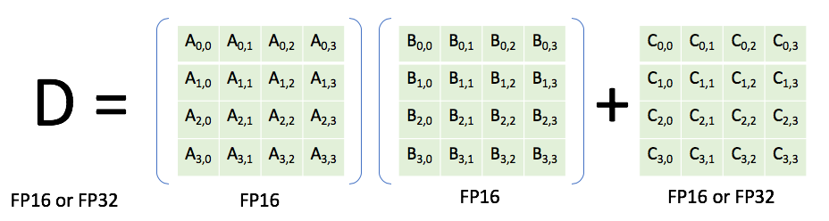
Nvidia Volta (e.g. V100, TitanRTX)
Generally, you are responsible for specifying a reduced precision: DL frameworks don’t do this automatically since it may impact your networks accuracy, convergence, etc
Features
INT8 & FP16 support
(Volta) Tensor cores: fused multiply-add units that support mixed precision (multiply in FP16, add in FP32). High performance: 120 TFLOPS (for the time).
High bandwidth memory, 2nd generation (HBM2) (vs. DDR)

Slide 23
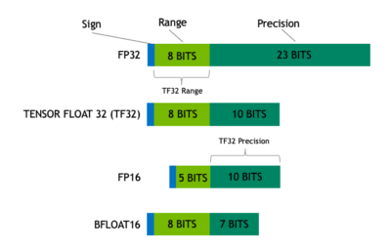
Nvidia Ampere GPUs (e.g. A100)
Features (see also https://servicedesk.surf.nl/wiki/display/WIKI/Deep+Learning+on+A100+GPUs )
Tensor Cores support more datatypes (FP64, TF32, FP16, BF16, Int8, Int4, Binary)
TensorFloat32 datatype:
Mixed precision uses FP16. Reduced range causes (potential) need for gradient scaling to prevent underflows

Slide 24
Nvidia Ampere GPUs (e.g. A100)
Features (see also https://servicedesk.surf.nl/wiki/display/WIKI/Deep+Learning+on+A100+GPUs )
Tensor Cores support more datatypes (FP64, TF32, FP16, BF16, Int8, Int4, Binary)
TensorFloat32 datatype:
TF32 tries to combine best of both worlds: range of an FP32 (no gradient scaling needed), but with reduced precision (for speedup & less memory)

Slide 25
Nvidia Ampere GPUs (e.g. A100)
Features (see also https://servicedesk.surf.nl/wiki/display/WIKI/Deep+Learning+on+A100+GPUs )
Tensor Cores support more datatypes (FP64, TF32, FP16, BF16, Int8, Int4, Binary)
TensorFloat32 datatype:
Automatically used unless
Environment variable NVIDIA_TF32_OVERRIDE=0 is set
torch.backends.cuda.matmul.allow_tf32 = False and torch.backends.cudnn.allow_tf32 = False are set

Slide 26
Nvidia Ampere GPUs (e.g. A100)
Model | Precision | Throughput (img/s) | Speedup (compared to FP32) | Loss (1st iteration)
ResNet50 | FP32 | 455.9 | 1 | 7.457645893096924
ResNet50 | TF32 | 750.6 | 1.65 | 7.456507205963135
ResNet50 | FP16 (input) + FP32 (accumulator) | 1087.6 | 2.38 | 7.45703125
VGG19 | FP32 | 212.7 | 1 | 6.9077839851379395
VGG19 | TF32 | 550.3 | 2.59 | 6.907783508300781
VGG19 | FP16 (input) + FP32 (accumulator) | 1099.8 | 5.17 | 6.90625
DenseNet121 | FP32 | 391.9 | 1 | 6.96142053604126
DenseNet121 | TF32 | 591.5 | 1.51 | 6.961450576782227
DenseNet121 | FP16 (input) + FP32 (accumulator) | 876.2 | 2.24 | 6.9609375
Source: https://servicedesk.surf.nl/wiki/display/WIKI/Deep+Learning+on+A100+GPUs

Slide 27
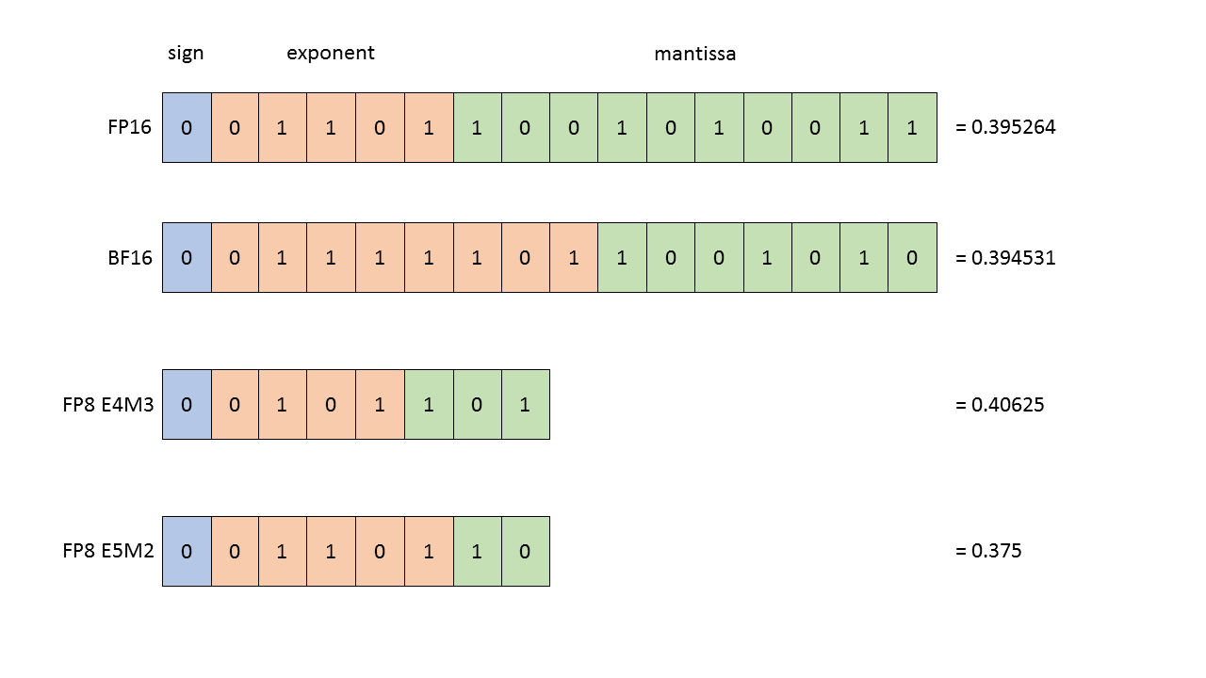
Nvidia Hopper GPUs (e.g. H100)
FP8 support
Transformer-specific optimizations

Slide 28
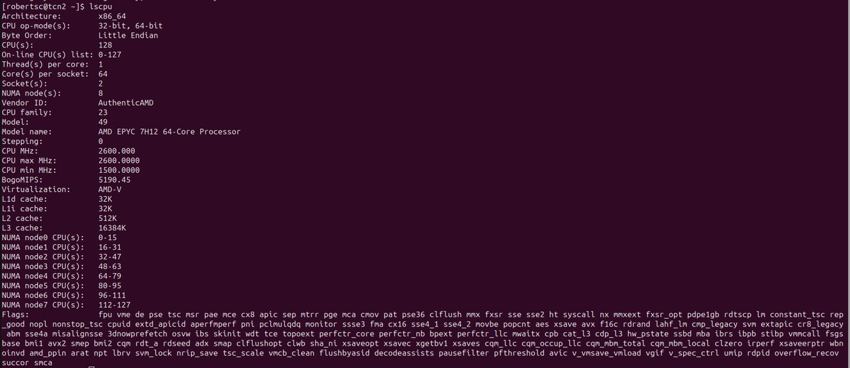
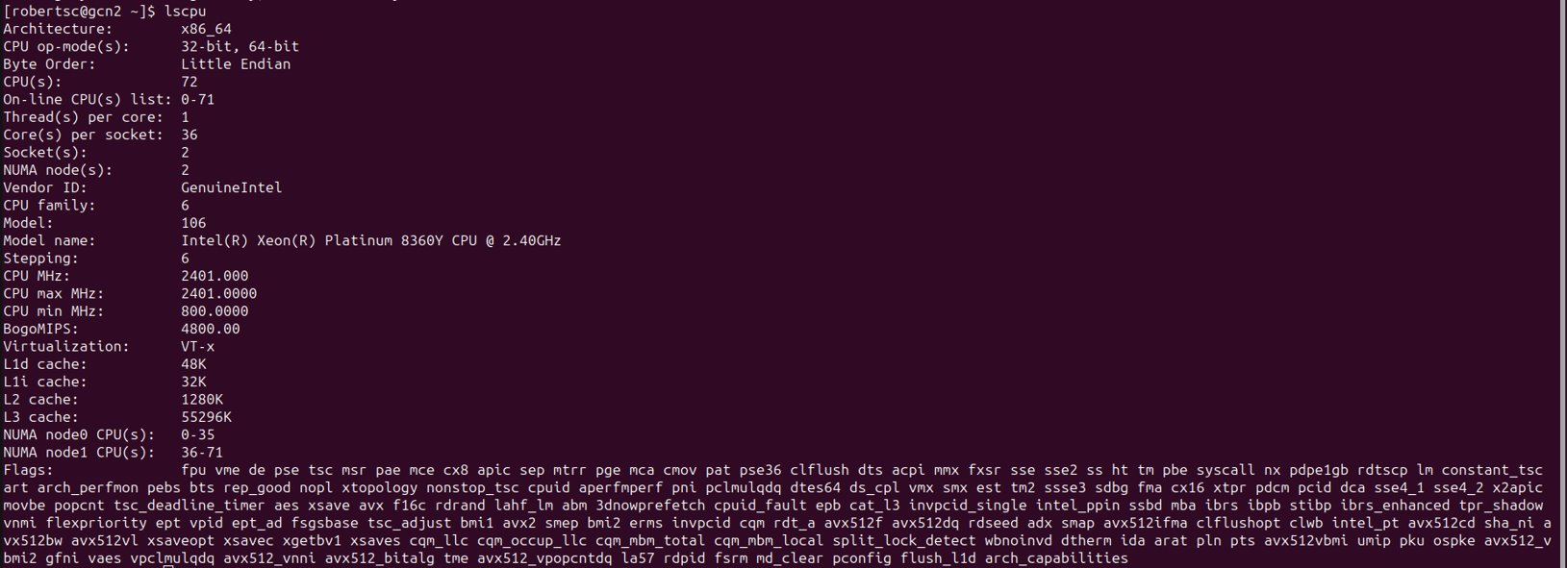
And on CPU:
Notes:
Add new cpus

Slide 29
Second S: Software
PyTorch/TensorFlow vs Numpy
PyTorch and TensorFlow have GPU support, Numpy does not
Numpy on AVX2....brrrr
Support for CUDA (Nvidia), ROCm (AMD), <insert exotic hardware here>?
E.g.: Intel SapphireRapids
IPEX: https://github.com/intel/intel-extension-for-pytorch
LUMI https://www.lumi-supercomputer.eu/
Support for lower precision
BFloat16, Float16?

Slide 30

Third S: Stack
Is my software compiled for my hardware
Pip install … ?
Module load PyTorch/2.1.2-foss-2023a-CUDA-12.1.1
Again: SapphireRapids? ROCm?
PyTorch is crazy: https://github.com/pytorch/pytorch/tree/main/third_party
PyTorch has given up on generic software management
Ptrblck: " (but for PyTorch most of the time it doesn't matter (if you're doing the usual stuff))

Slide 31
Wait ... so what happens?
You call torch
(Manual) Dispatching
E.g. scatter_add_ -> Message passing in Graph-NNs
Torch (python) determines the most appropriate function to call
Dispatching
Torch (C++/CU) calls the CPU/GPU kernel
Dispatching
Low-level lib performs actual calculation
Dispatching
PyTorch Dispatcher: http://blog.ezyang.com/2020/09/lets-talk-about-the-pytorch-dispatcher/
Your choices matter

Slide 32
In practice: PyTorch + Snellius
We only have NVIDIA GPUs
72x4=288 NVIDIA A100
88x4=352 NVIDIA H100 (added recently)
Makes optimization a bit easier for you
You only need to spend a year sifting through documentation
https://servicedesk.surf.nl/wiki/display/WIKI/Deep+Learning+on+A100+GPUs
Or ask us... :)
Every EINF/NWO small grants has a default of 4 consultancy hours

Slide 33

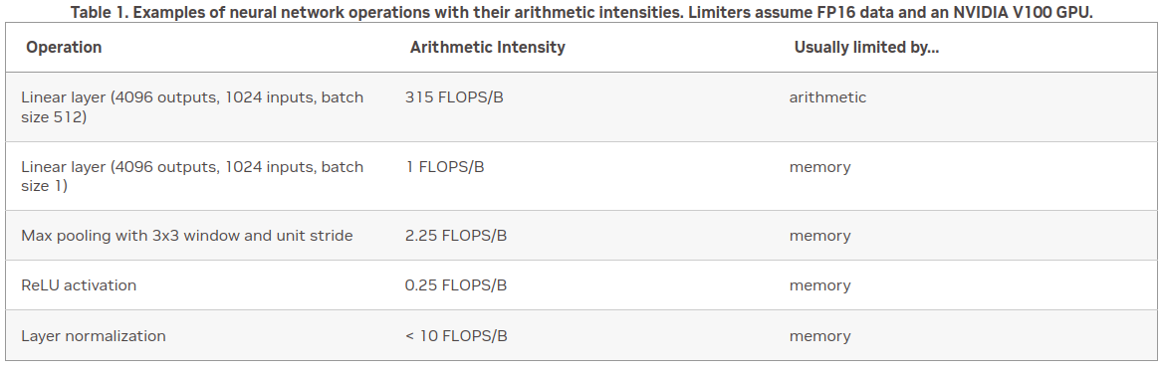
Rapidfire: implementation details
How fast do you want to go?
What is your goal?
Largest model possible?
Best validation performance?
Submit a paper to ISC '25?

Slide 34
Rapidfire: implementation details
How fast do you want to go?
https://pytorch.org/docs/stable/notes/cuda.html
https://docs.nvidia.com/deeplearning/performance/dl-performance-memory-limited/index.html
https://docs.nvidia.com/deeplearning/performance/index.html
Duncan: "You can take any piece of code, spend 6 months optimizing it, and then write a paper about it"

Slide 35

First of all and last of all: monitoring & profiling
You don't know if you don't know
Monitoring:
Wandb
CPU: Top / htop
GPU: nvidia-smi / nvtop / dcgmi
Profiling
Torch-tb-profiler / Hollistic Trace Analysis
Nsight systems
Nsight compute

Slide 36
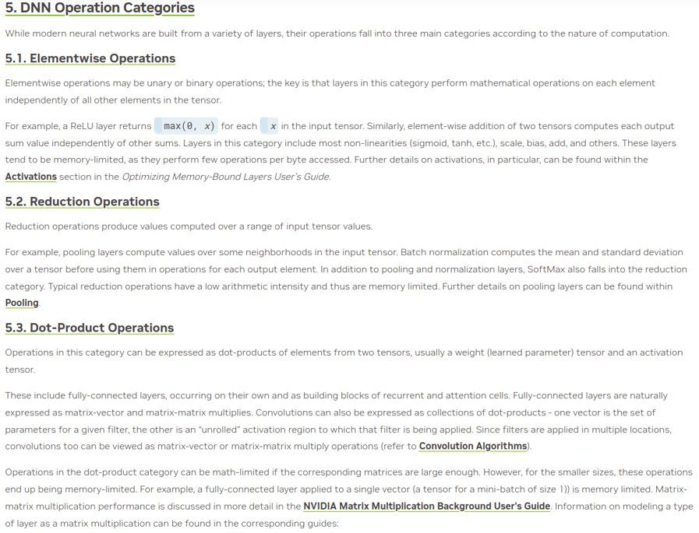
Rapidfire: implementation details

Slide 37
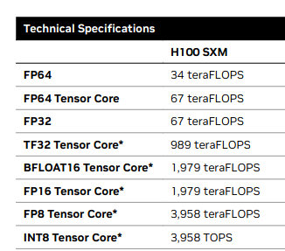
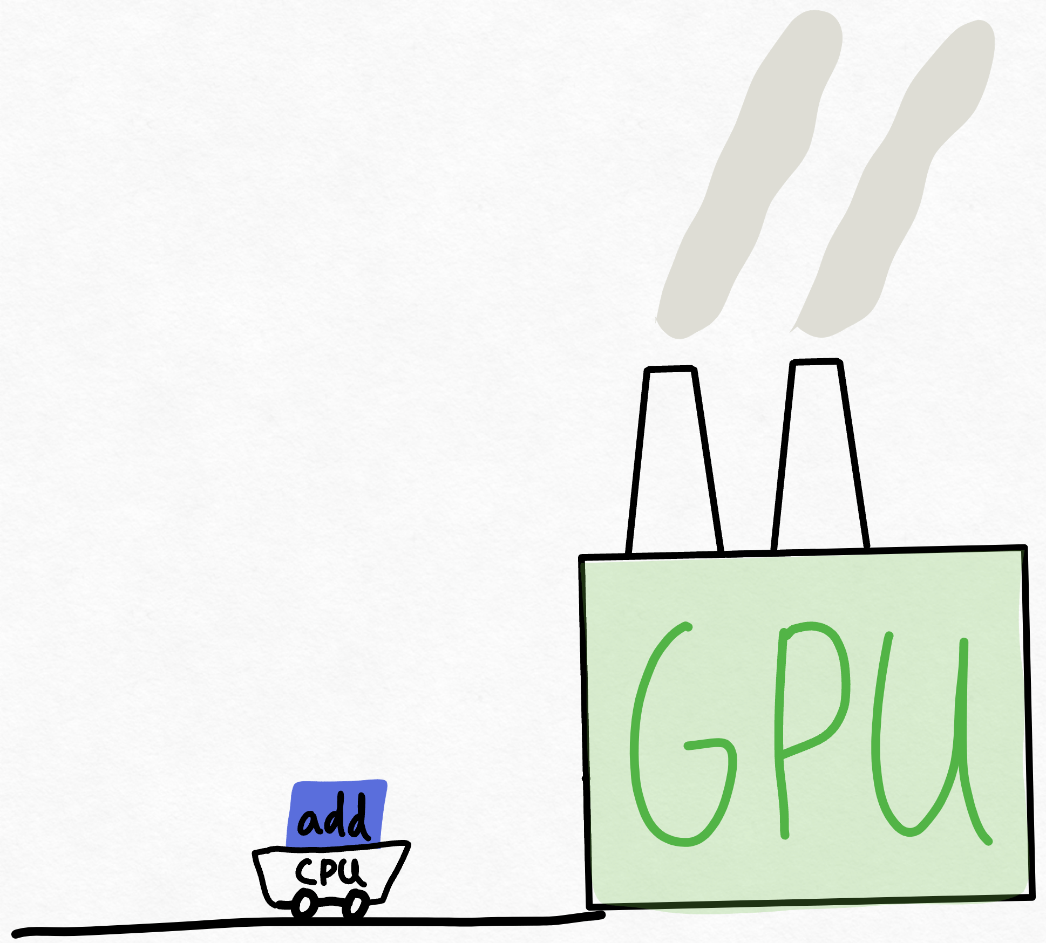
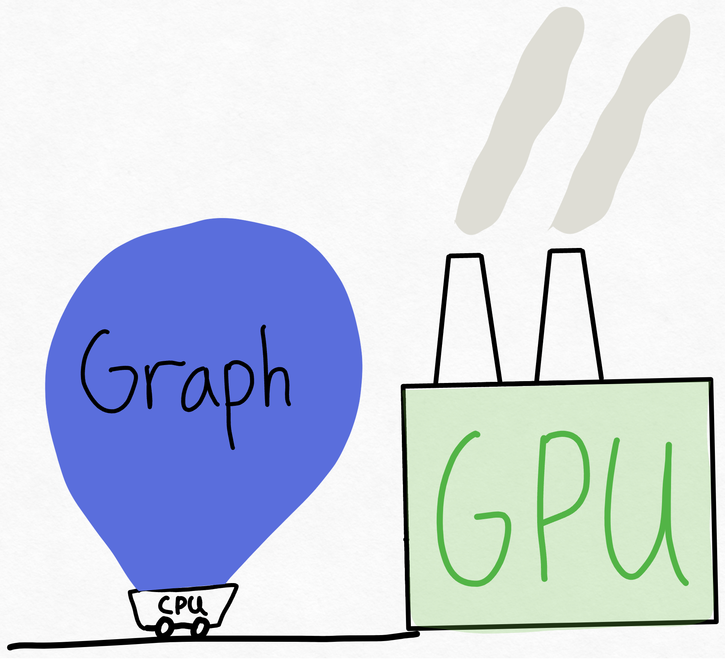
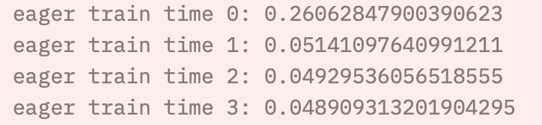
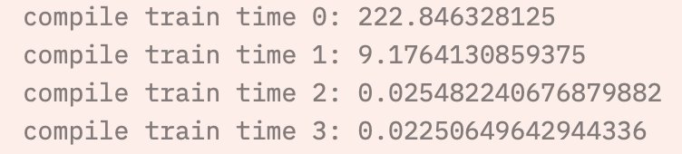
Level 0: We will reject your grant request if you don't do this (and don't have a good reason not to do so)
Torch.compile
Using lower precision, e.g. BFloat16

Slide 38
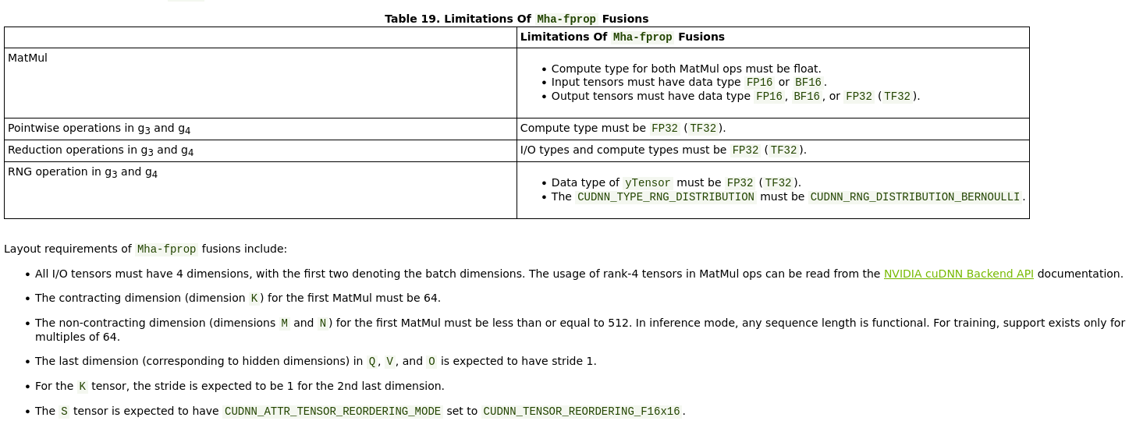
Level 1: Doesn't impact model performance; 'tricks'

Slide 39
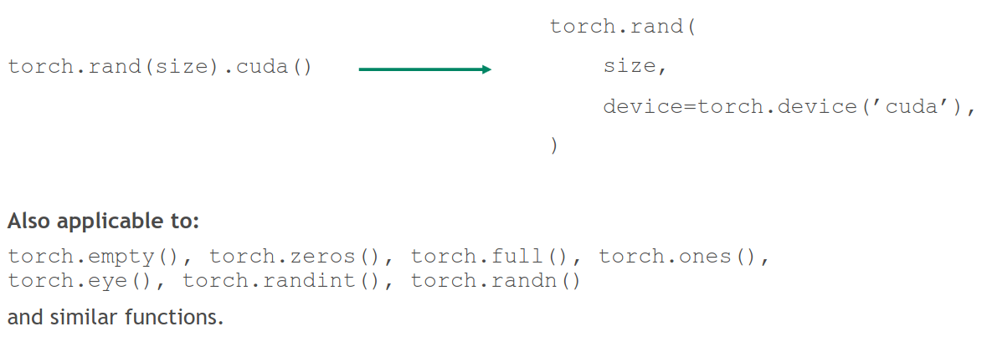
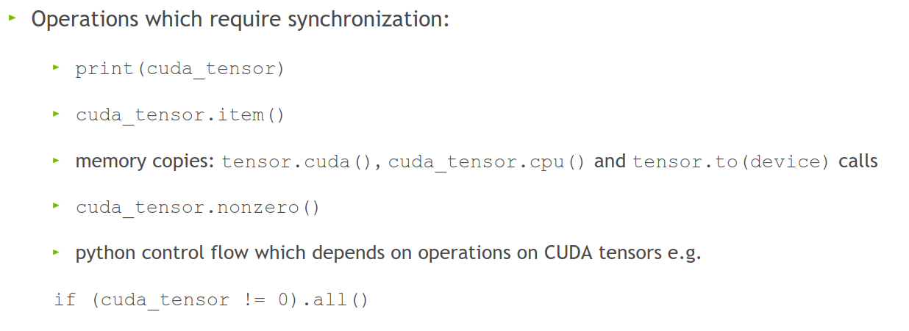
Level 1: Doesn't impact model performance
Avoid CPU-GPU sync
Create tensors directly on the device
Don't aggregate tensors which still require grad, e.g.: losses.append(loss) (:o)
instead, detach (loss.detach())

Slide 40
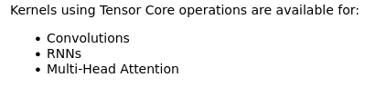
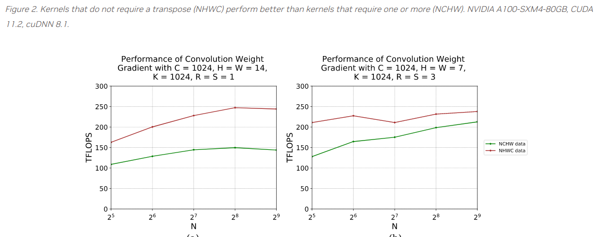
Level 1: Doesn't impact model performance; 'tricks'
torch.backends.cuda.matmul.allow_tf32 = True
The default in PyTorch (silently)
torch.set_float32_matmul_precision('high')
torch.backends.cudnn.benchmark = True
Empirically benchmarks to find fastest method
Align bytes: multiples of 2, 8, 1024
DNN libraries want nicely aligned memory
torch.channels_last
Helps with memory alignment and reduces cache misses
Reinforcement learning specific:
Use Nvidia MPS (basically a scheduler for GPUs)

Slide 41

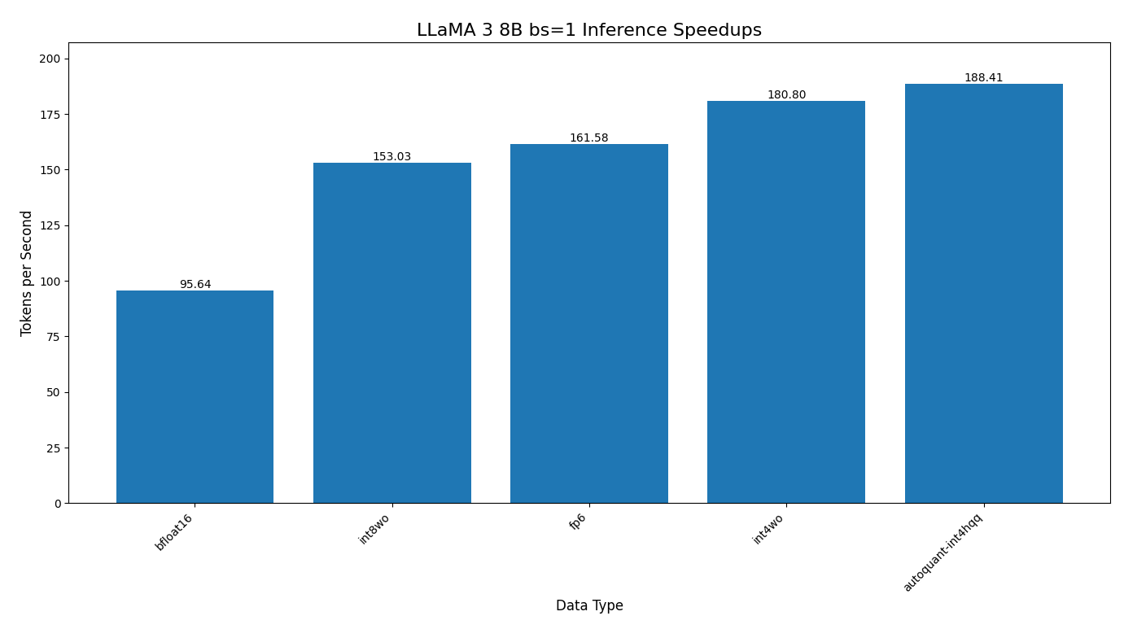
Level 2: Danger zone
Quantization is becoming more and more important
Huggingface makes it easy for you, e.g. LLM.int8
PyTorch is finally catching up: https://pytorch.org/blog/pytorch-native-architecture-optimization/

Slide 42
Level 2: Danger zone
torch.backends.cuda.matmul.allow_fp16_reduced_precision_reduction = True
Lol:
torch.backends.cuda.matmul.allow_bf16_reduced_precision_reduction
Torch.set_float32_matmul_precision('medium')
Cast model and data to (B)Float16 before the forward pass
We're not supposed to...but:

Slide 43
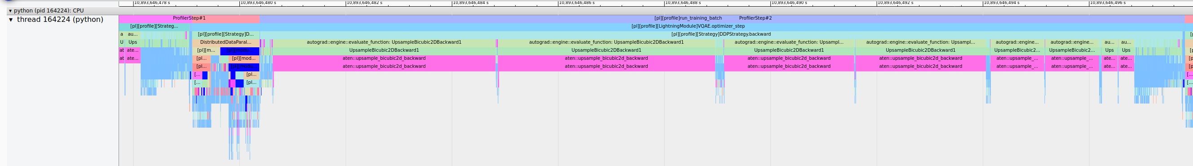
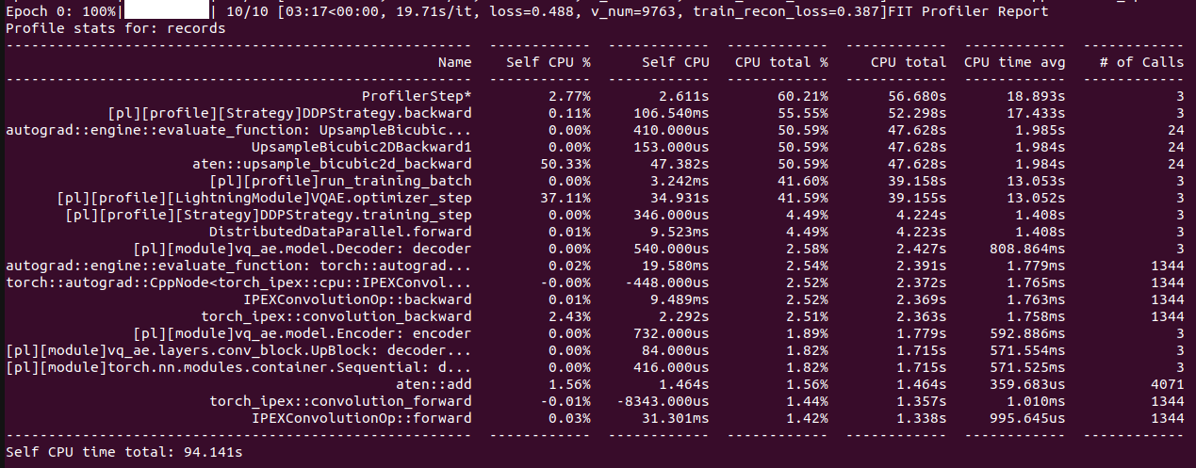
Change your model
Worst case scenario:

Slide 44
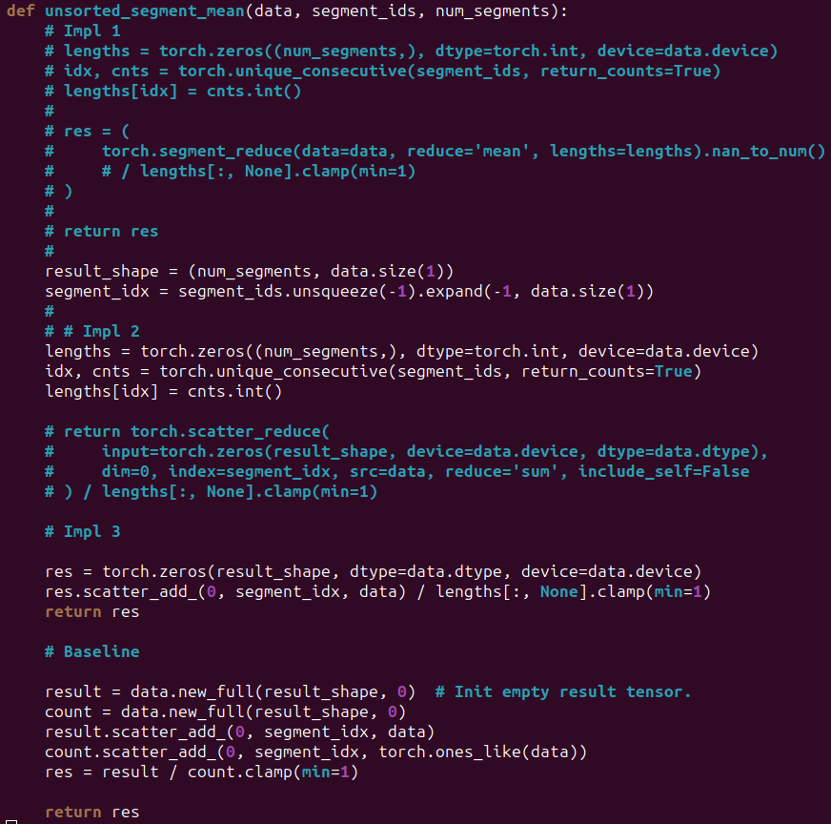

Slide 45
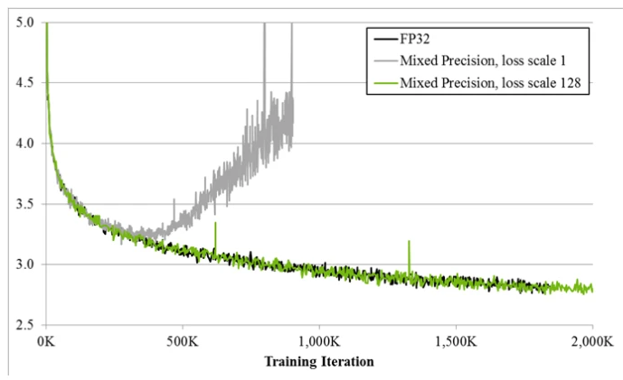
Always
Have a baseline
Check convergence statistics

Slide 46

Profile
Get a grip on your model’s performance
Profile
Profile
Profile
Also important: profile

Slide 47
More generally; listen to Duncan:
Start small
Have a goal
Profile your code

